Slide 1
Furniture Shop Management System
Internal Guide: Mrs. Sonali Nemade
Project Members:
Rutuja Malusare and Shweta Mohite

Slide 2
Introduction
Furniture Shop Management System is to manage Furniture Shop business and it is implemented with inventory management.
There are four main modules in this system . Which are;
Profile management
Inventory management
Sales management
Financial management
This system provides an ease to add & retrieve data about employees , departments , suppliers and customers.
It helps in maintaining stock details & salary details ,generate bills.

Slide 3
Problem definition
No immediate retrieval of information is possible :- The information is very difficult to retrieve and to find particular information like the stock of a specified furniture, balance, collection, as all the information is stored in the traditional data stores i.e. entry registers and we have to search it manually. This results in inconvenience and wastage of time and may be incorrect information.
No immediate updation in record is possible :- various changes to the information like employee details i.e. if any employee has changed his address or he got the higher post ,his mobile number which are required. If he wants to update the payment details of any employee, and machine updation, stock updation are difficult to make as paper work is involved.

Slide 4
Error prone manual calculation: - Manual calculations are error prone and take lot of time this may result in incorrect information. For example calculation of annual balance by the administrator from the bill, payment paid to the employee, manager and subtracting all the expenditure made for maintaince.

Slide 5
Scope of the System
This system is very reliable & efficient as compared to manual system. Data can be rechecked before submitting to Database.
It will result in fewer mistakes.
This system provides large amount of storage of information. The necessary details of Employee, supplier, furniture Stock and etc.. are stored in database which also helps in easy retrieval of data. It will help in preparing periodic reports.

Slide 6
Objectives of the System
To design and develop a system as user friendly as possible.
To reduces clerical work.
This not only reduces manual work but also time and storage Requirements.
To provide the reports related to Employee, Supplier,Furniture Stock and etc..
To improve data accuracy, integrity, consistency, retrieval of information and processing speed.
Make a Furniture management system which will take inputs for the purchase orders and enter them to a database by validating it.

Slide 7
Keeping the records of transactions like,
Customer’s details.
Customer’s registration.
Number of Stock available.
Number of orders.
Purchase Details.
Unique username & password assigned to admin.
Admin registration provides security to the system by making the system password protected.

Slide 8
Advantages of the System
System is User friendly.
Less time consuming.
Easy to maintain Records.
No loss of Data
Storing & Generating of reports are Easy.

Slide 9
Limitations
-Booking of advance order is not done.
-Only one customer can login at time.
-Only one type of item can be ordered at time.

Slide 10
Need for Computerization
Now a day’s need of computerized system is increase as our life become fast.
In computerized system various authentication facility are provided which makes our system secure.
So, if you want best performance in portability of large complex Database, then there is only one option of using computerized system

Slide 11
UML Diagrams

Slide 12
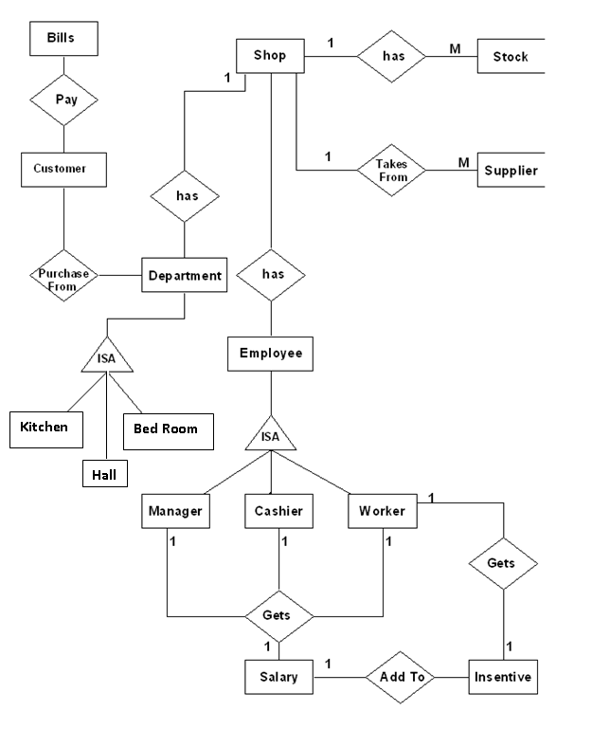
E-R Diagram

Slide 13
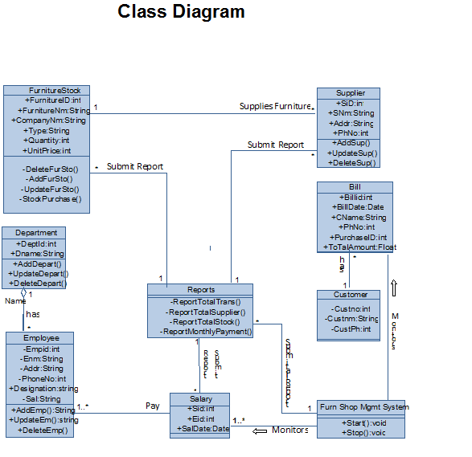

Slide 14
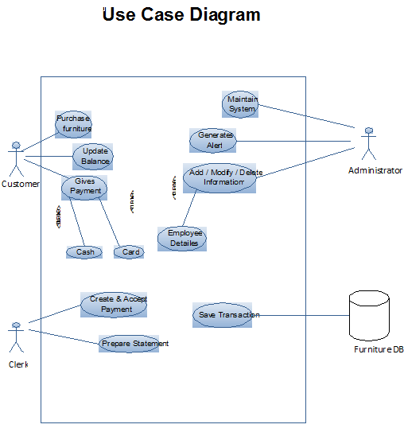

Slide 15
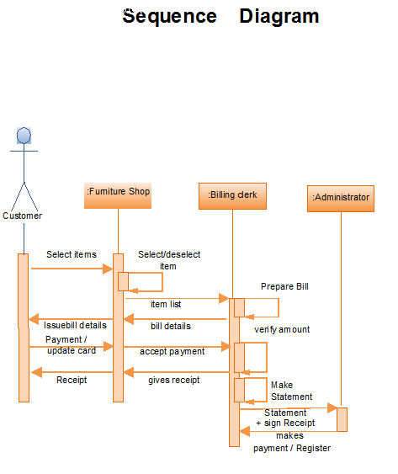

Slide 16
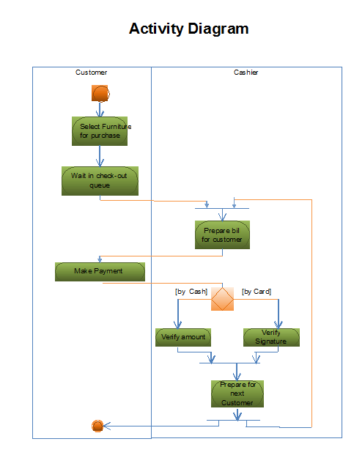

Slide 17
Data
Dictionary

Slide 18
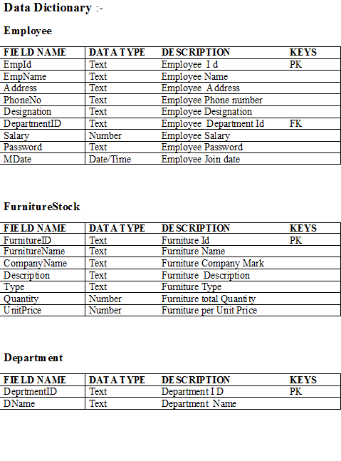

Slide 19
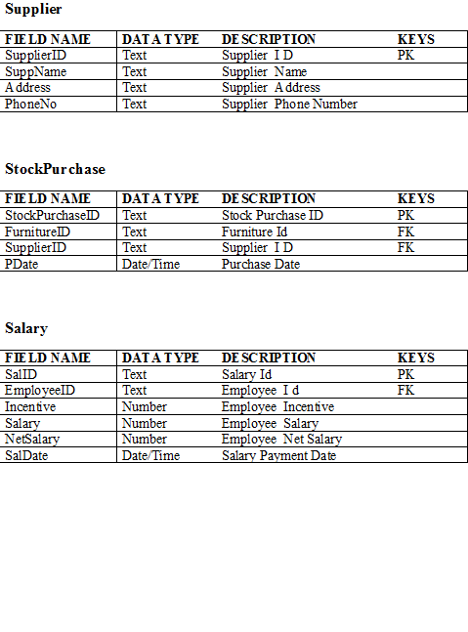

Slide 20
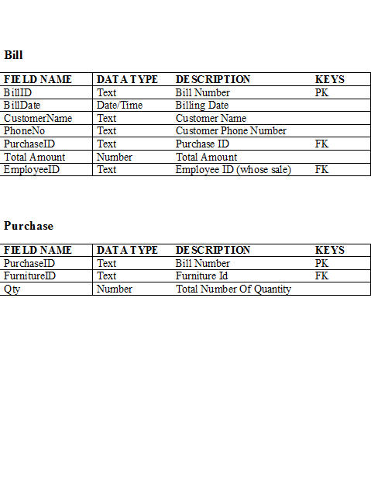

Slide 21
System Design/ UML Diagrams

Slide 22
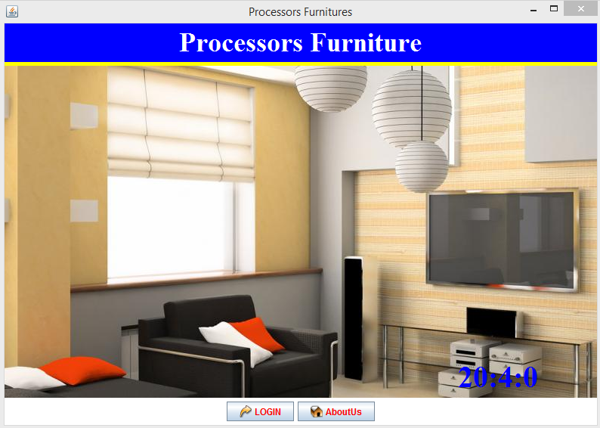
Welcome Screen

Slide 23
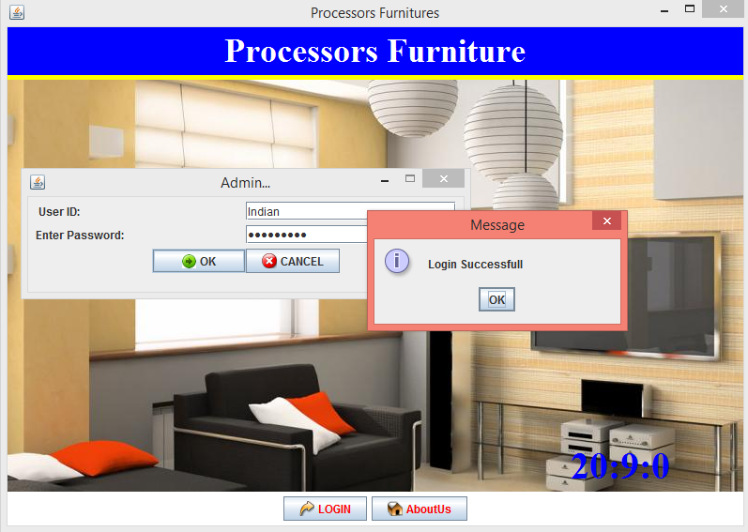
Login Screen

Slide 24
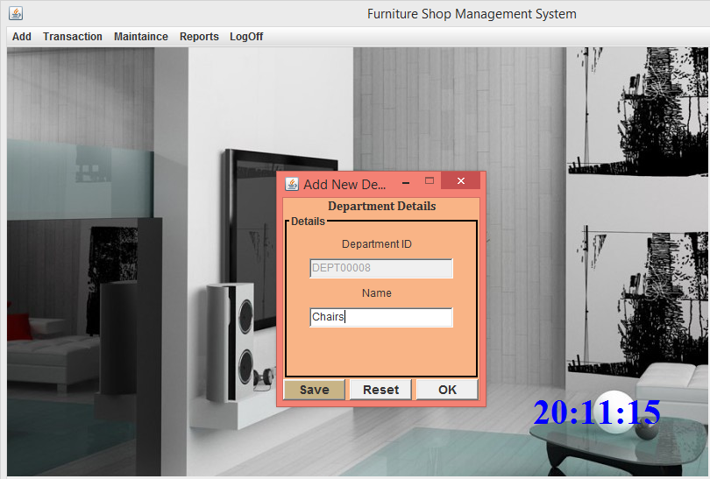
Add department

Slide 25
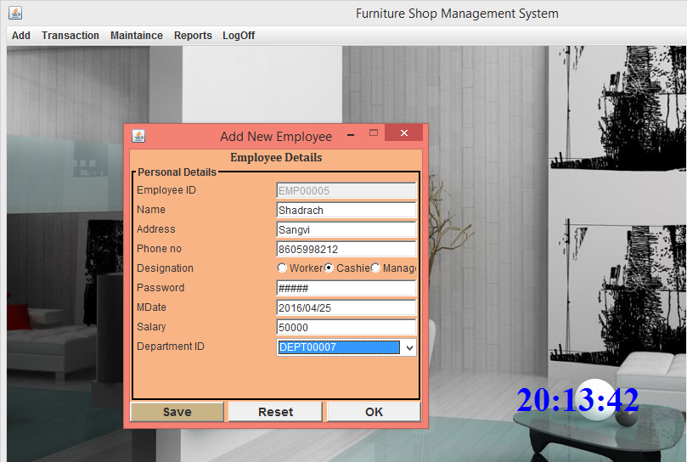
Add employee

Slide 26
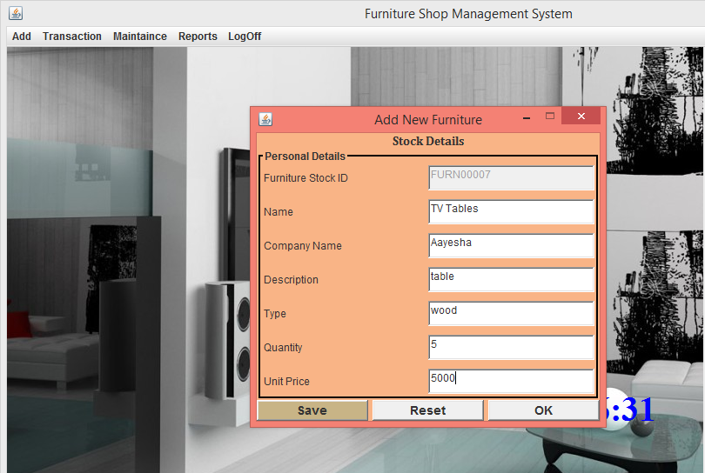
Add furniture stock

Slide 27
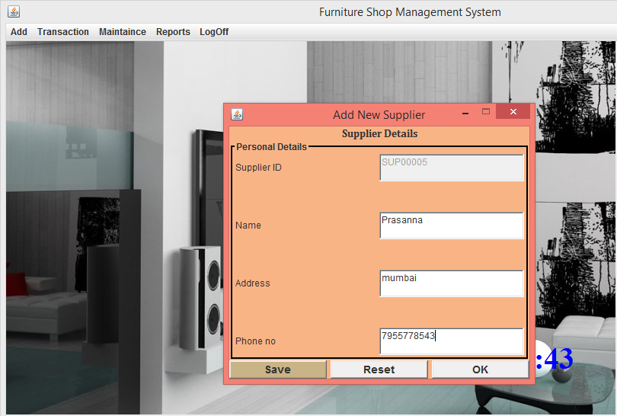
Add new supplier

Slide 28
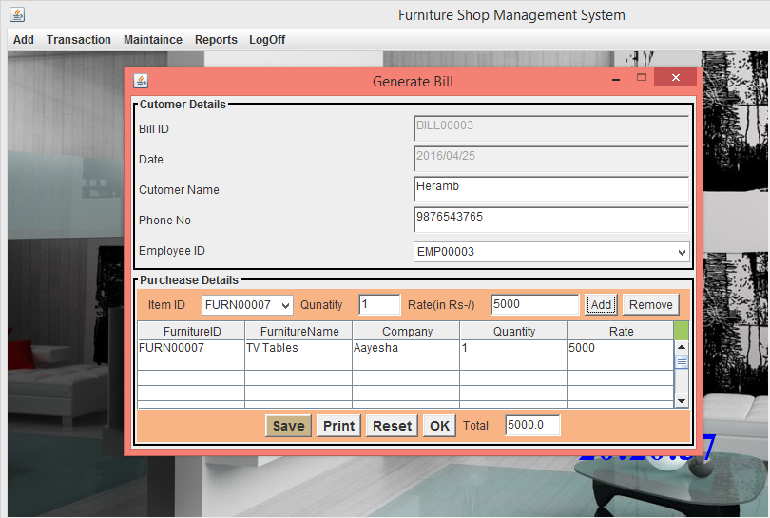
Generate bill

Slide 29
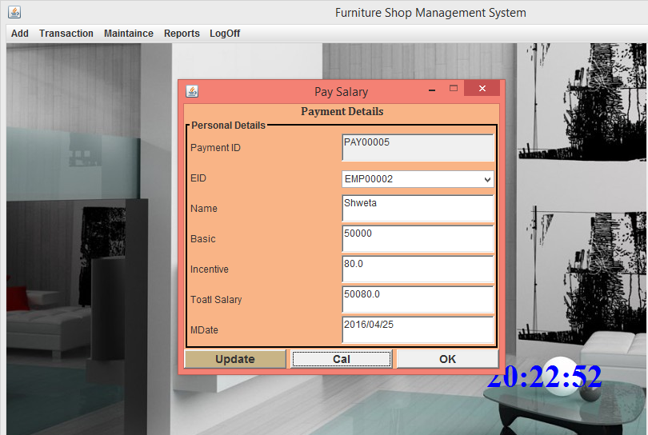
Pay salary

Slide 30
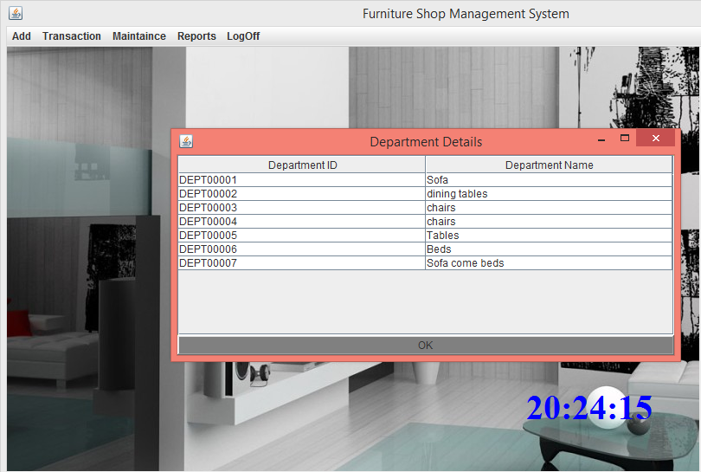
Reports of department

Slide 31
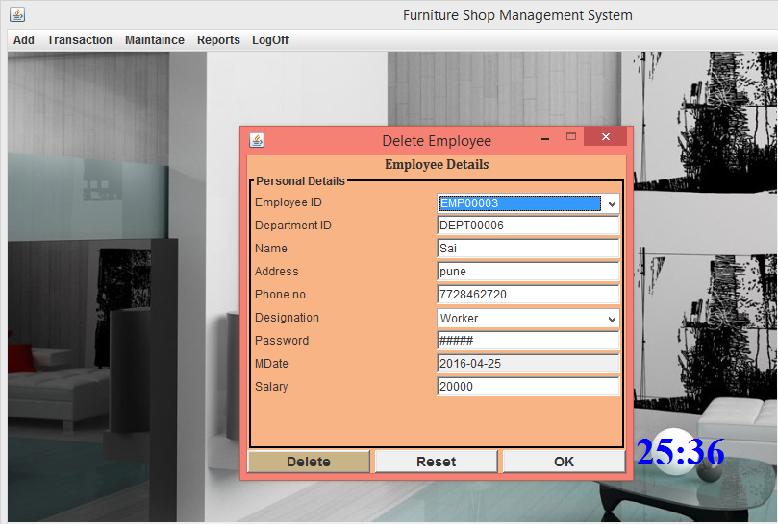
Delete emp

Slide 32
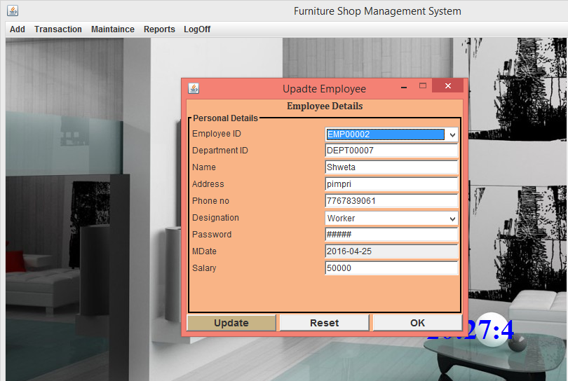
Update emp

Slide 33
Future Enhancement
We don’t have back up like print receipt, in Future we are looking for it.
We don’t have provide any search facility for Furniture or any department, so we are looking for it.
We don’t have Separate Log in for employee so we will be try to do it near future.
This Application is standalone in future it will be connected to network for Centralization of users Information.
Booking of advance order is done.
Many customer can login at time

Slide 34
Conclusion
Proposed System is :-
User Friendly :
The System has got much Simplified screen which makes the system fast enhances quick and Accurate data.
Validations Check :
The System has various Validation Checks and it also gives appropriate error message and Provides the necessary help.
Report Generation :
The System can generate various reports giving employee details, working details, deleted details etc.
Easy to Learn :
The System is easy to understand, this is mainly due to simple functionality. Even a Layman can be trained to use this system.

Slide 35
Thank
You !!!!!!

